Slide 1
Fabulous = F# Functional FOR YOUR APP
Don Syme, Microsoft Researcher, F# Contributor
+ assistance from Mark Allibone, Jim Bennett, Jason Imison, Miguel de Icaza, Phillip Carter, Fabulous Community Contributors

Slide 2
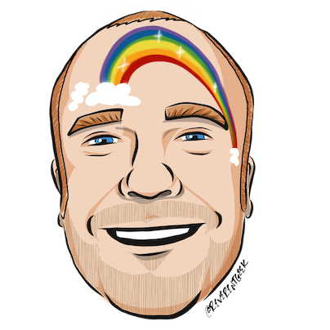







thanks
Timothé Larivière also Zaid-Ajaj
co-maintainer on Fabulous, author of ElmishContacts and ElmishPlanets demos
Jim Bennett
Great talks on Fabulous!
Mark Allibone
Swiss MVP , @mallibone
Frank Krueger
ImmutableUI was inspiration and initial partial list of Xamarin.Core bindings
Boris D. (github @dboris)
authored “Elmish.Forms” (“half-elmish” for static views only)
Jason Imison
F# in Visual Studio for Mac and Xamarin
Eugene Tolmachev
Creator or “Elmish” for Fable, used for WPF and others
Justin Sacks and others
Creators of “Elmish.WPF” (“half-elmish” for static views only)
Alfonso, Maxime, Steffen and many others
The Fable gang

Slide 3


Slide 4
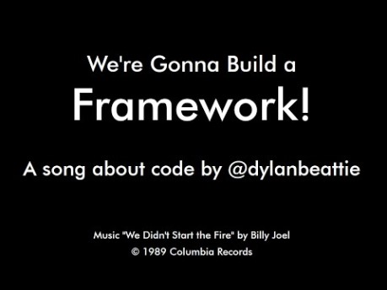

Slide 5
First, a little about F#

Slide 6
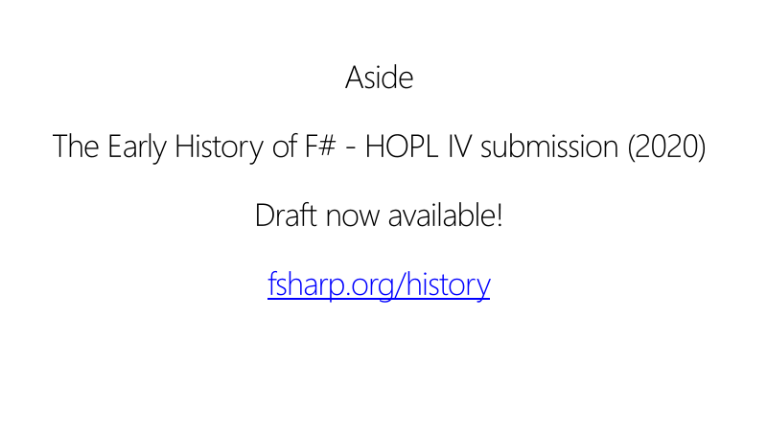

Slide 7
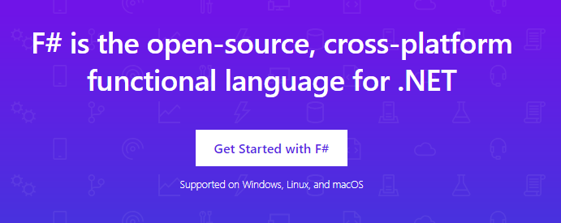
www.microsoft.com/net/

Slide 8
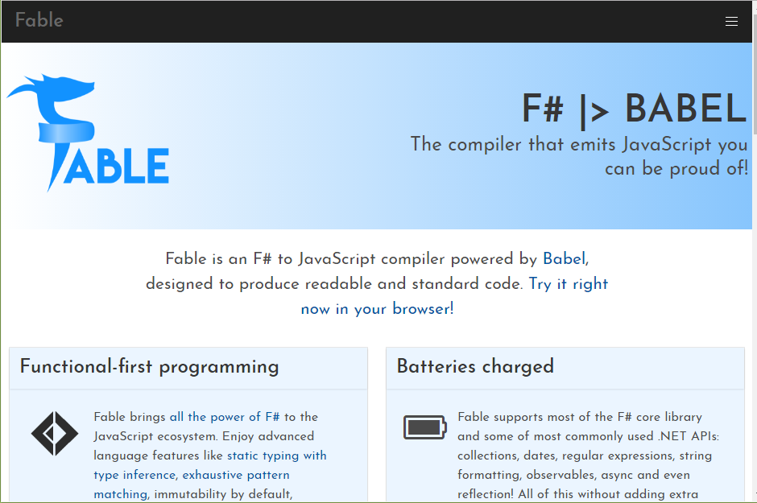

Slide 9
TL;DR – Where we are now
F# is open, cross-platform, neutral, independent
The F# Compiler Service powers other tools
F# 4.6 now complete!
.NET Core for Linux/OSX
All F# language and tooling is accepting contributions
Fable for F#-to-Javascript
SAFE for F# fullstack
The F# community is self-empowered
fsharp.org
VSCode, VS for Windows, Mac
Xamarin tools for Android, iOS, macOS etc.

Slide 10
The F# Language Design Process github.com/fsharp/fslang-design github.com/fsharp/fslang-suggestions

Slide 11
F# 4.0 ✔ True shift to cross-platform open engineering ✔ Long laundry list of language items ✔ Normalized core library ✔ Type providers more powerful ✔ Better debugging, tooling, performance ✔ ~20% compiler perf improvement
https://github.com/fsharp/fslang-design/tree/master/FSharp-4.0

Slide 12
F# 4.1 ✔ Optional large scope cycles more on this later) ✔ Result<T,Error> in standard library ✔ Unboxed (struct) tuples ✔ Unboxed (struct) records ✔ Unboxed (struct) unions ✔ More bits and pieces
https://github.com/fsharp/fslang-design/tree/master/FSharp-4.1

Slide 13
F# 4.5 ✔ Span<T> high perf type-safe non-allocating code ✔ Improved async debugging ✔ More bits and pieces
https://github.com/fsharp/fslang-design/tree/master/FSharp-4.5

Slide 14
F# 4.6 ✔ Anonymous records ✔ More bits and pieces
https://github.com/fsharp/fslang-design/tree/master/FSharp-4.5

Slide 15
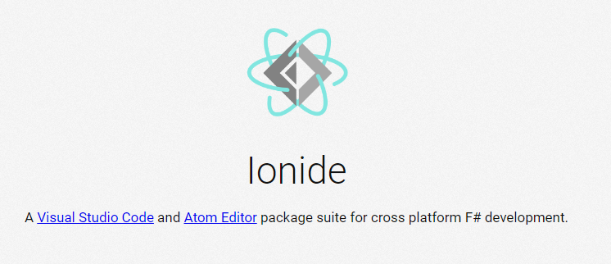
VSCode + Ionide = Cross-Platform F# Editing Love

Slide 16
F# and .NET Core (Linux, OSX, Windows) dotnet new -lang F# dotnet build docs.microsoft.com/dotnet/core/

Slide 18
The context
Initially F# embraced functional-first programming but lacked opinion on functional-first app development
Fable solves this for Web
But F# devs also need to be able to make Mobile and Desktop Apps
Notes:
Some good options existed but hadn’t quite taken hold. “winforms designer! WPF designer! Xaml designer on Mac! webforms designer! Xcode designer! Class designer! class browser!”. Some semi-functional architectures too (WebSharper UI.Next, Gjallahorn, others). ReactNative and other options are perceived as being functional-friendly. Can we make Xamarin friendly for F# developers?

Slide 19

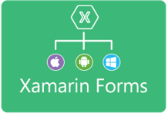












Situation: The world of UI is developing
OO programming
Complex mutable models
Declarative static UI
View in 2nd markup language
Complex designer tooling
Functional programming
Simple declarative models
Declarative dynamic UI
View in same language DSL
Simple live coding tooling
MVU
(model-view-update)
MVVM
(model-view-viewmodel)

Slide 20
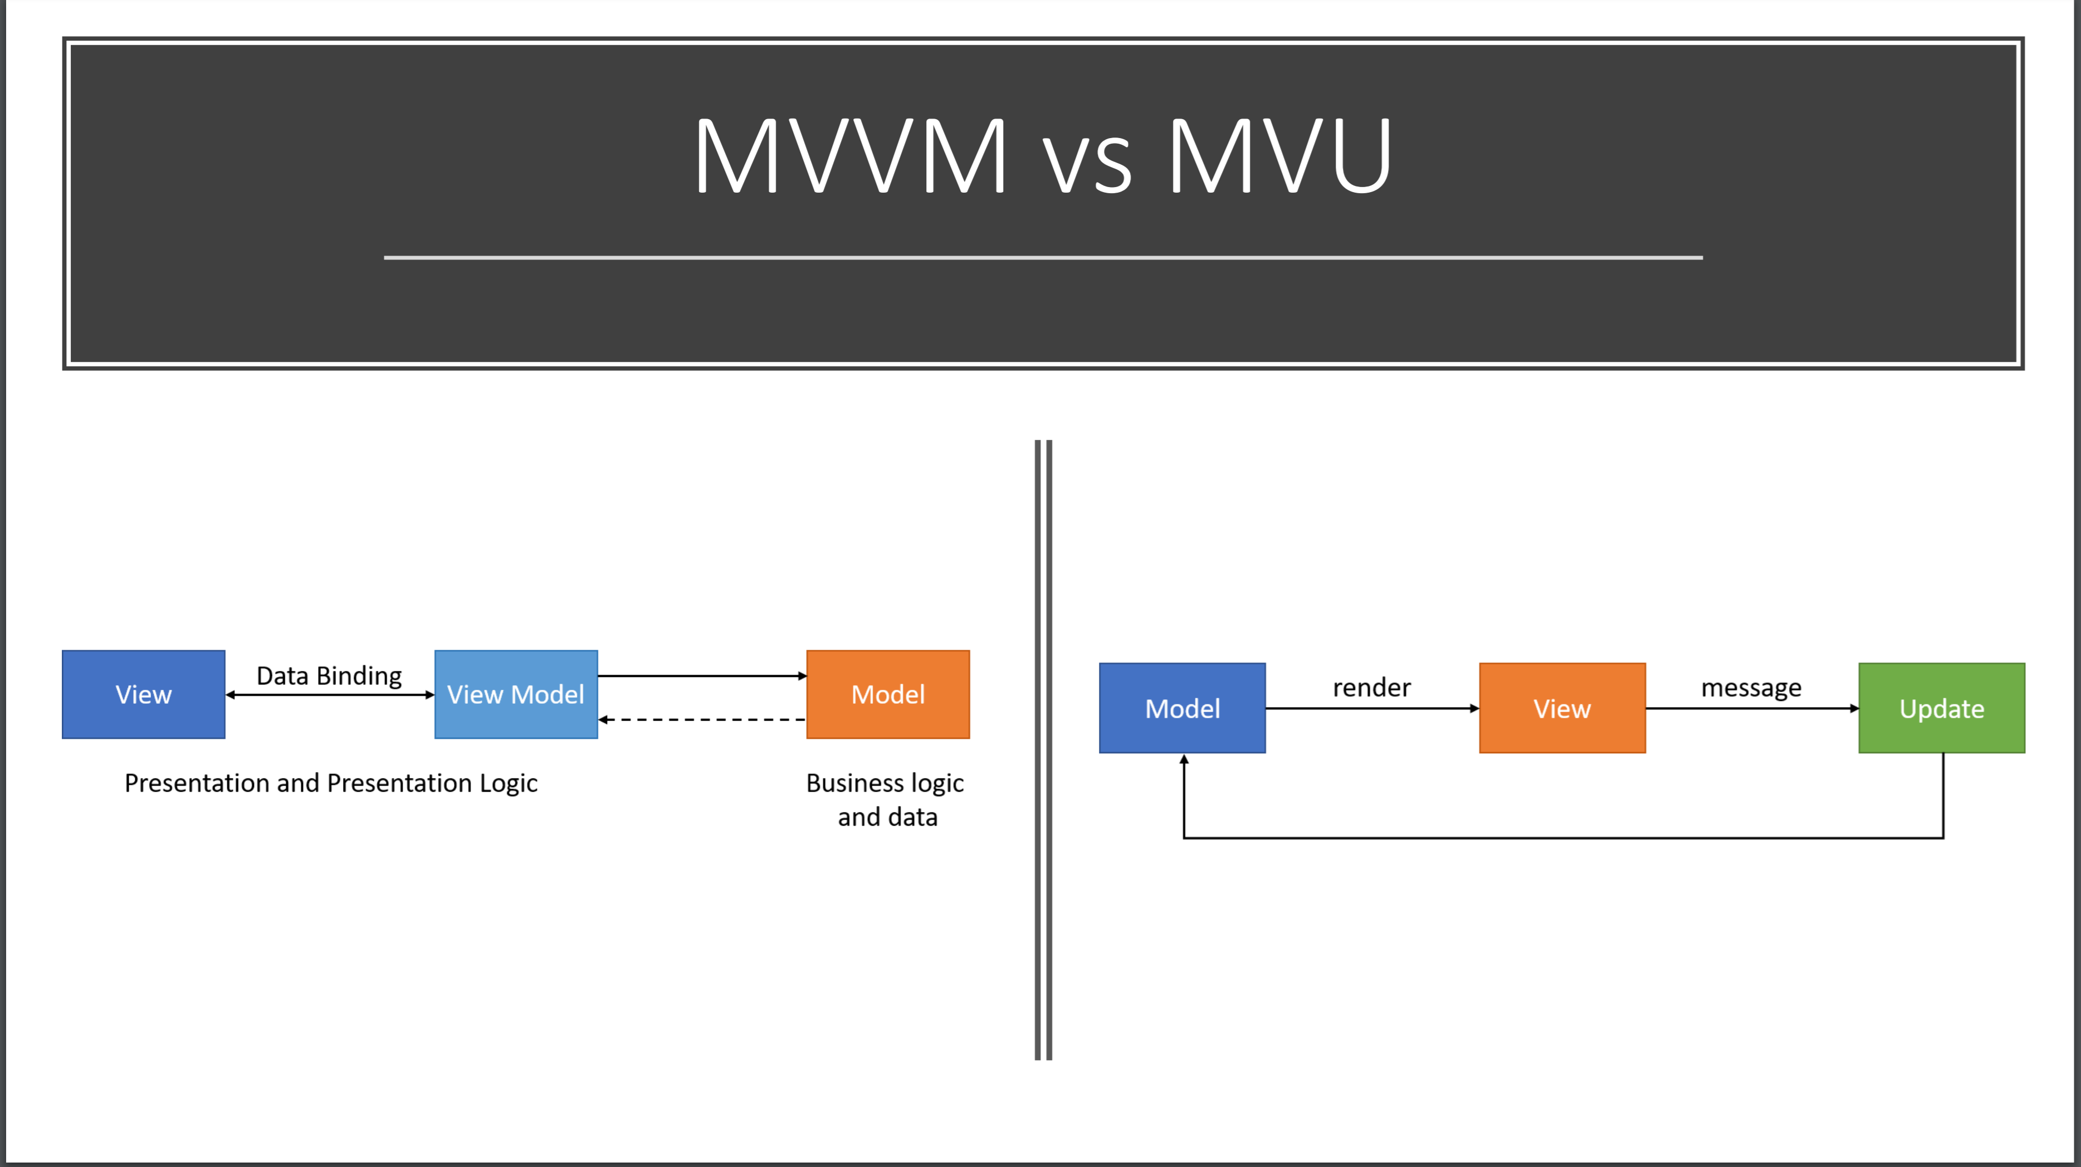

Slide 21
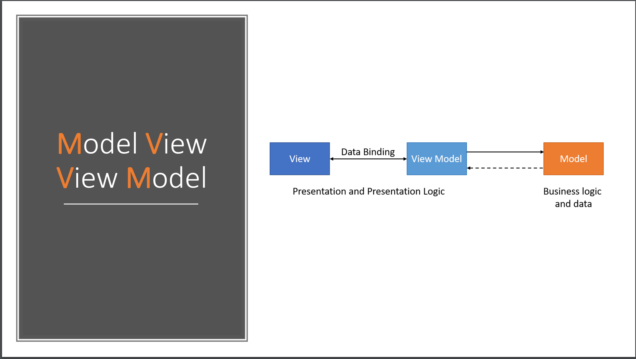

Slide 22
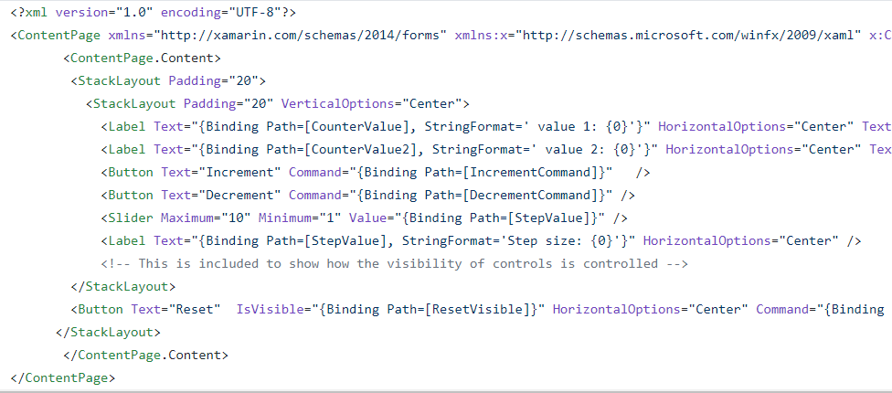
The VIEW DSL
Xaml looks like this:

Slide 23
THE PROBLEM WITH XAML
A core problem: Xaml
Xaml assumes “designers” will “sliced off” UI from code into a separate DSL.
Xaml is static, with layers of complexity (e.g. templating), and code-like constructs (behaviours, convertors), and requires complex designer tooling (which often fails).
Xaml stems from a fundamental category mistake in 2003 (“dynamic UI should be separated into a static markup language”)

Slide 24
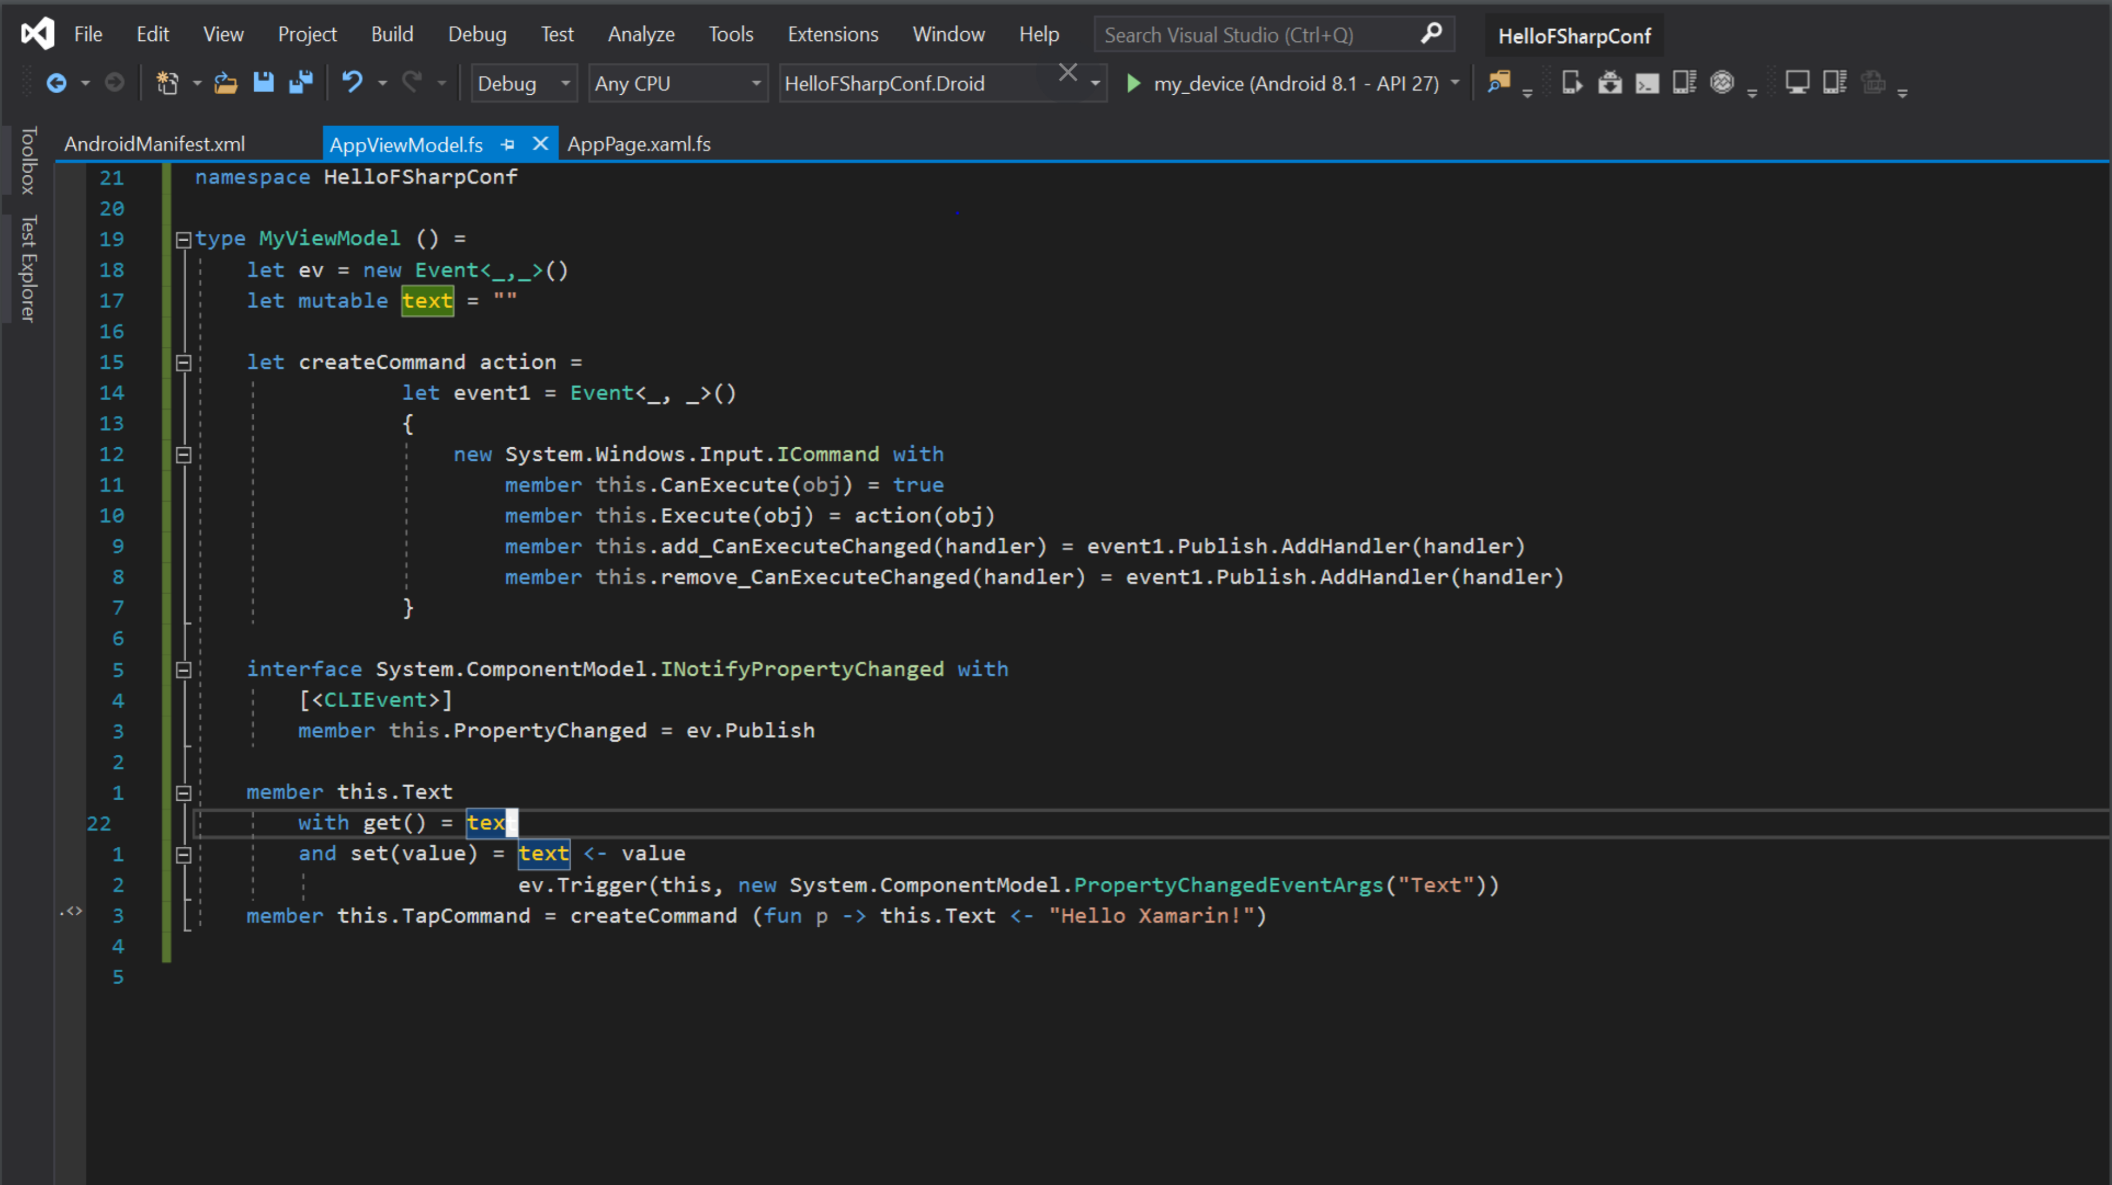

Slide 25
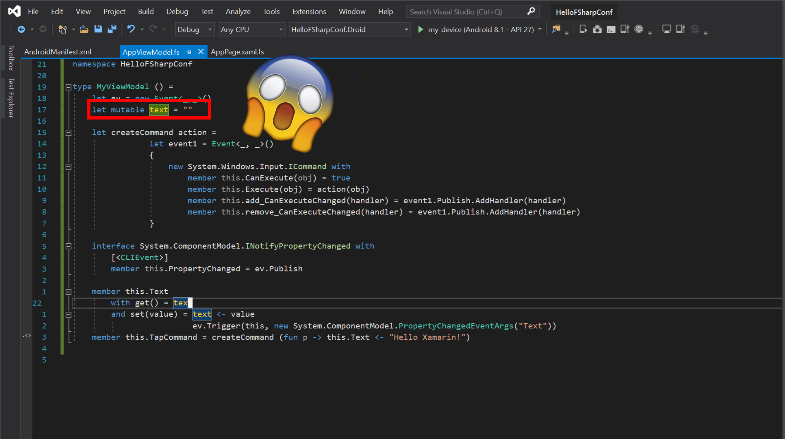

Slide 26
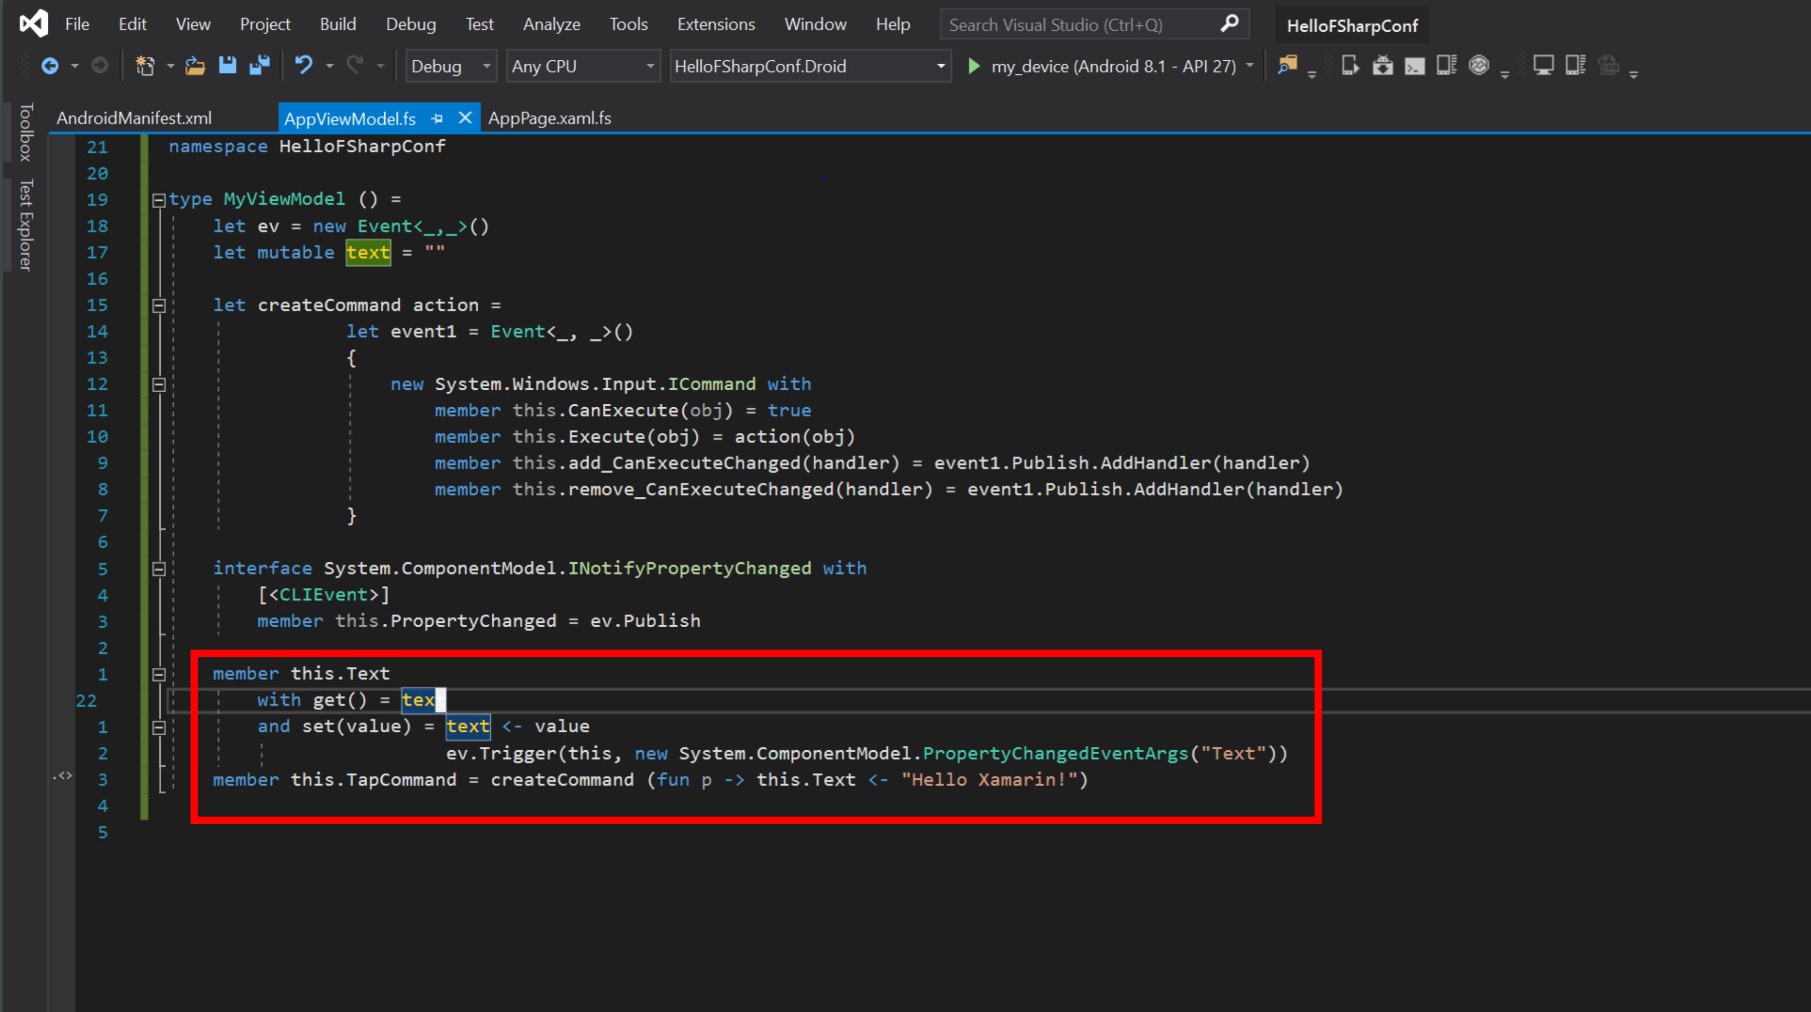

Slide 28
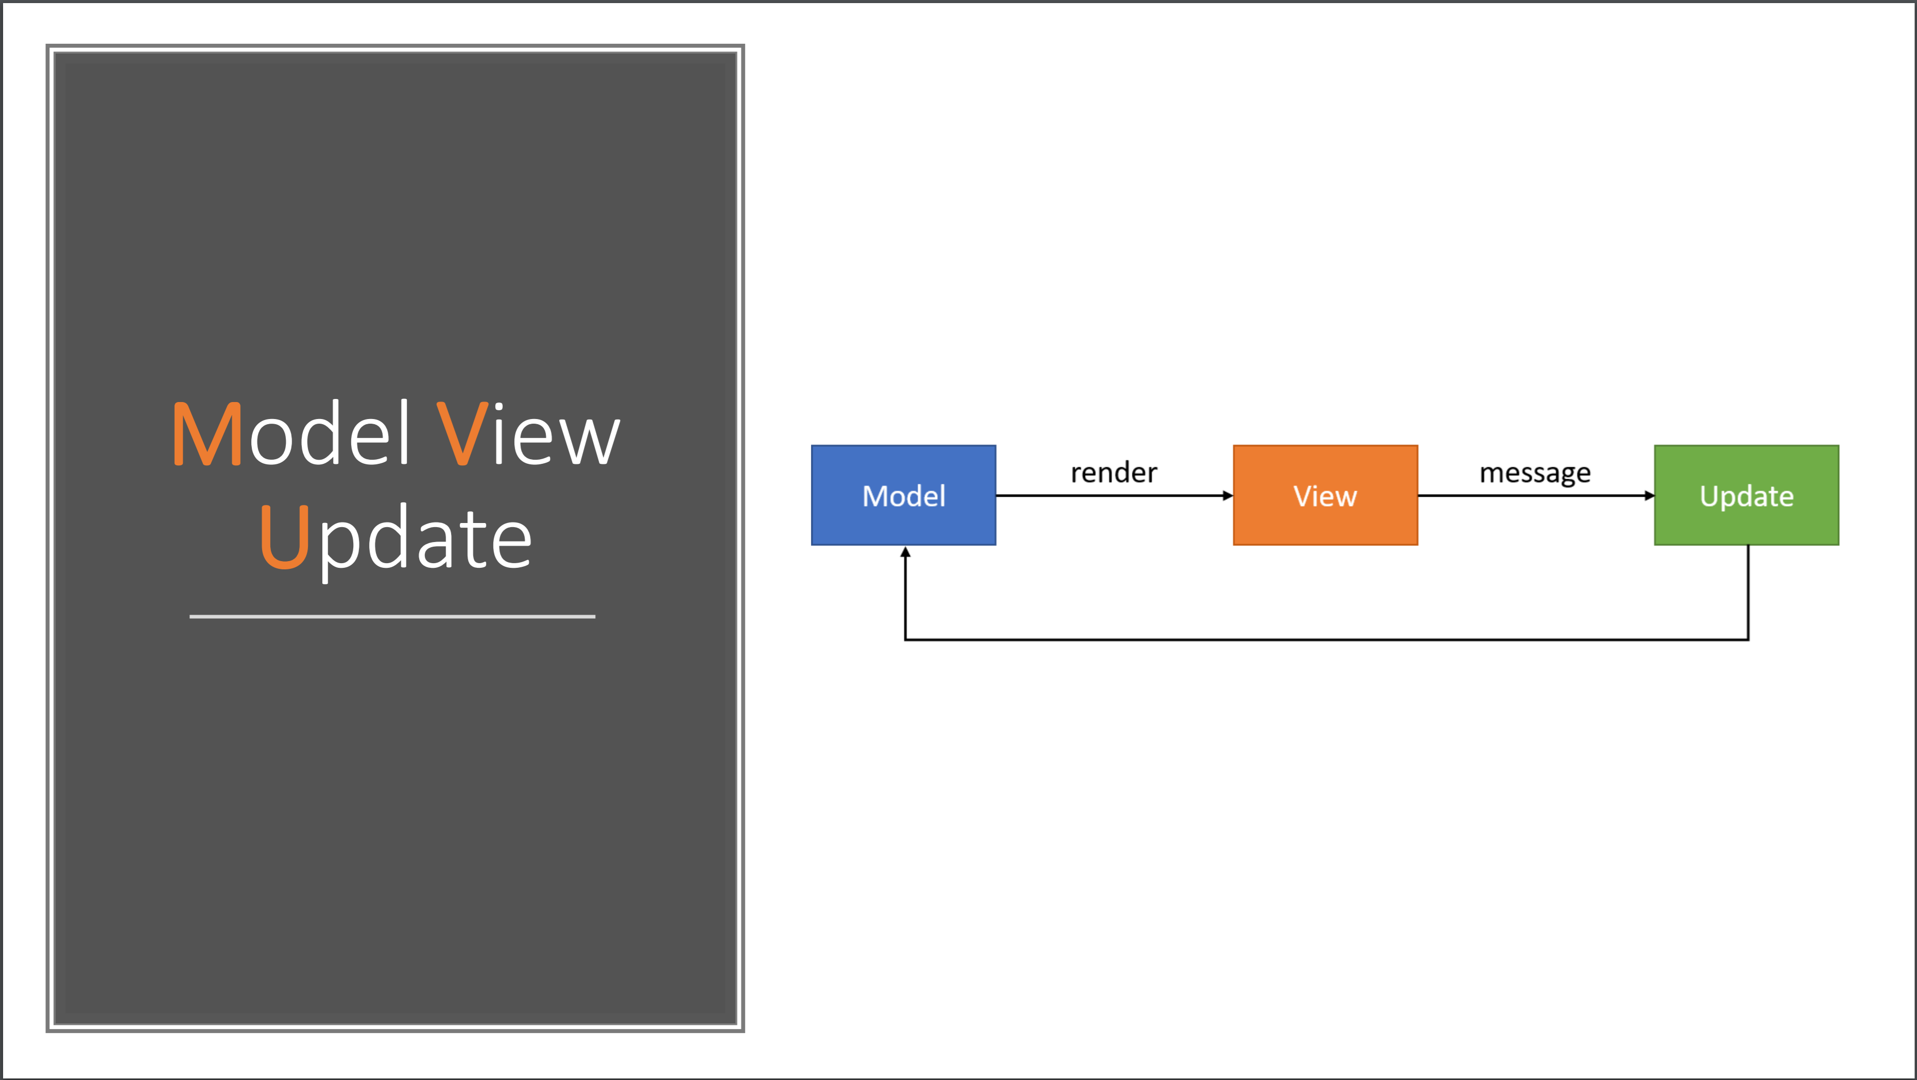

Slide 29
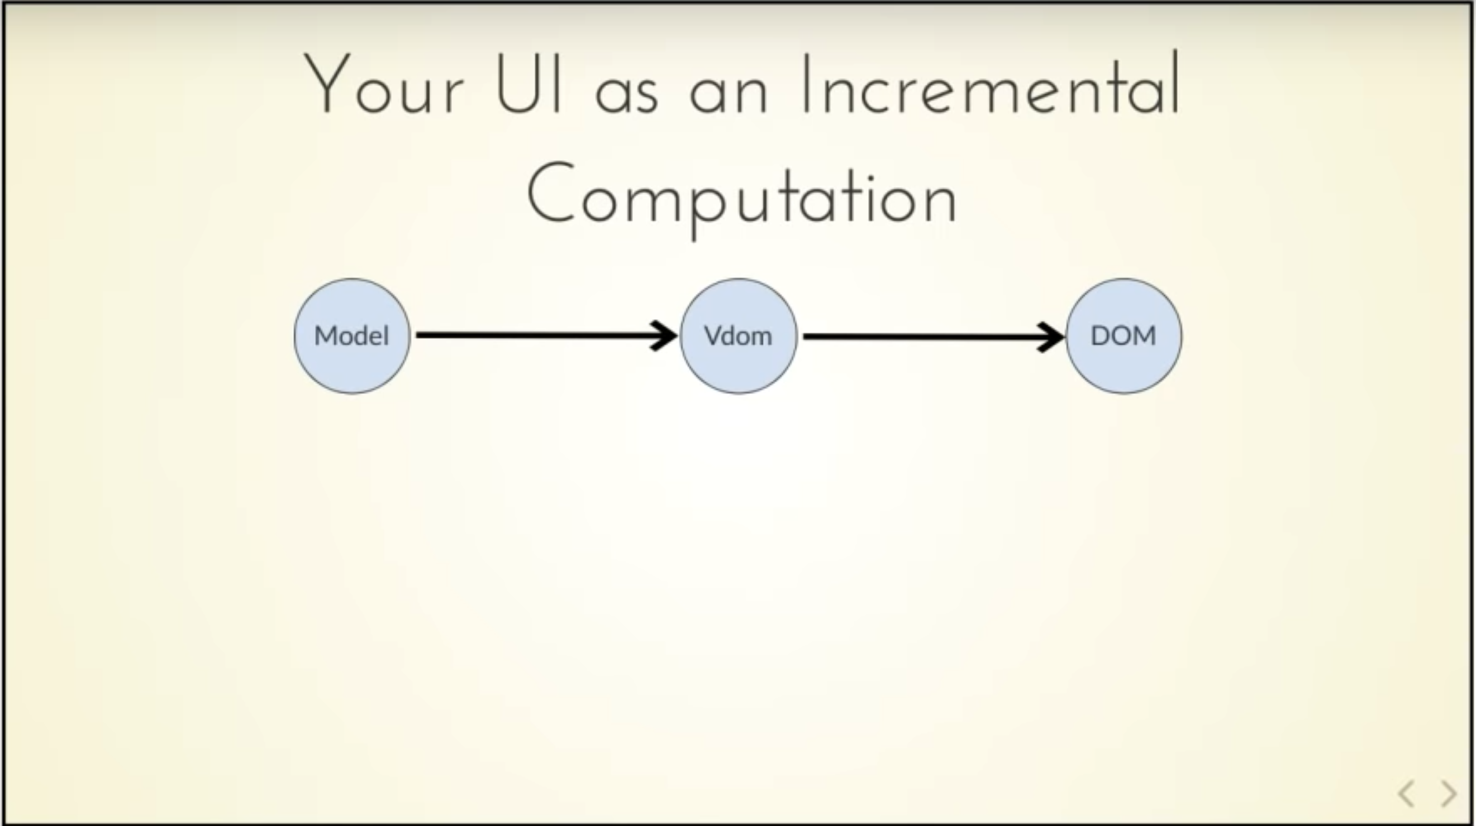
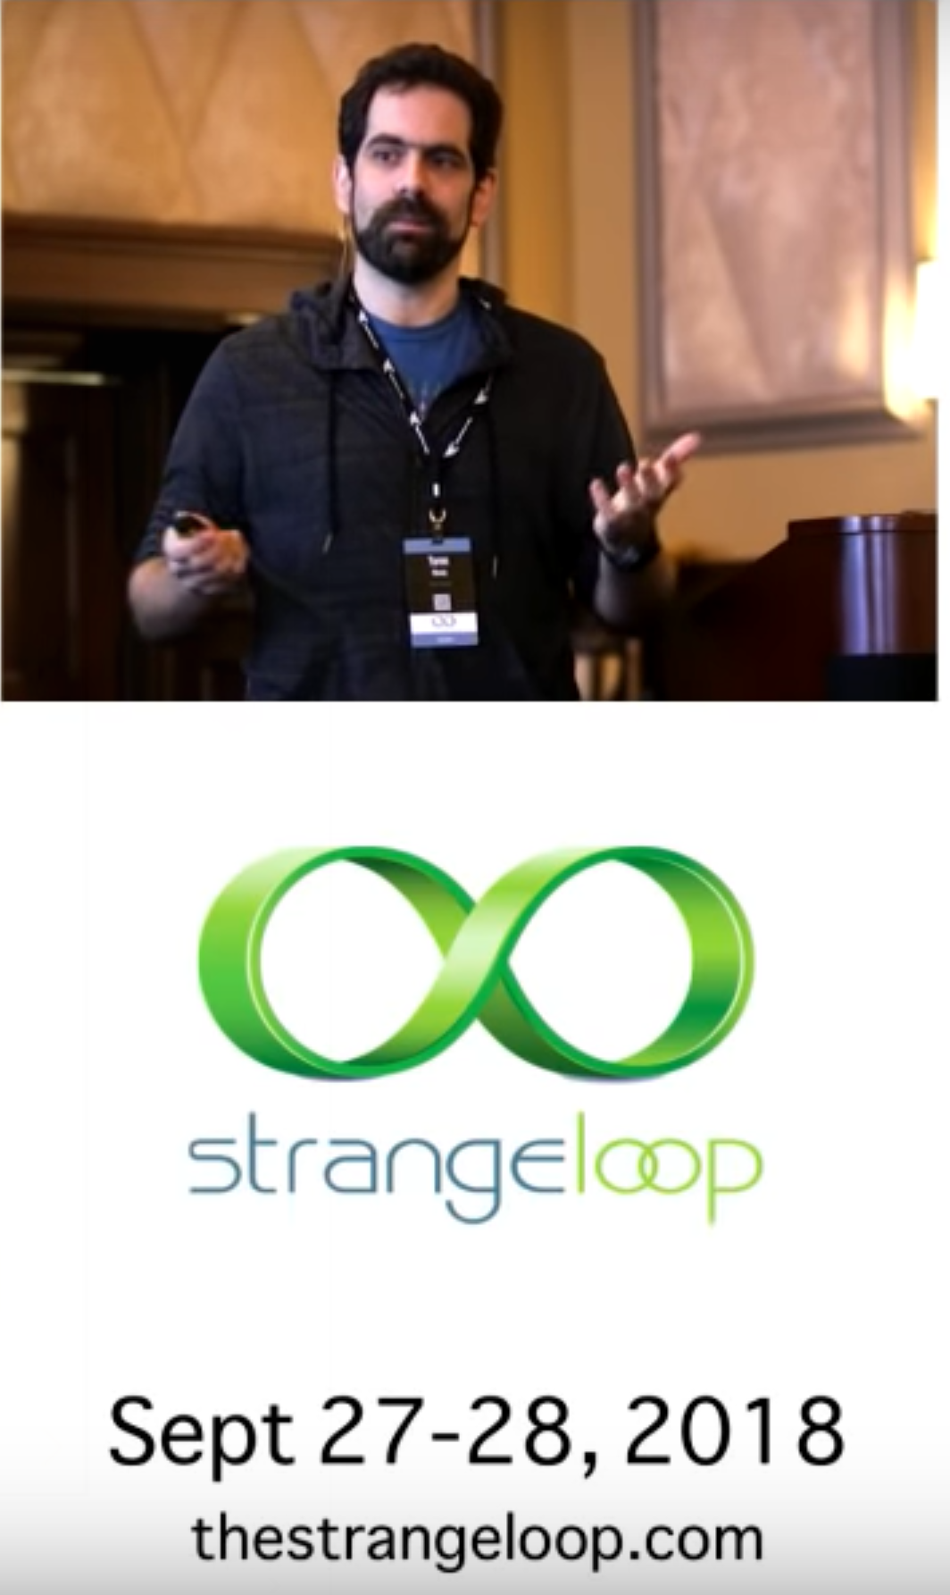

Slide 30
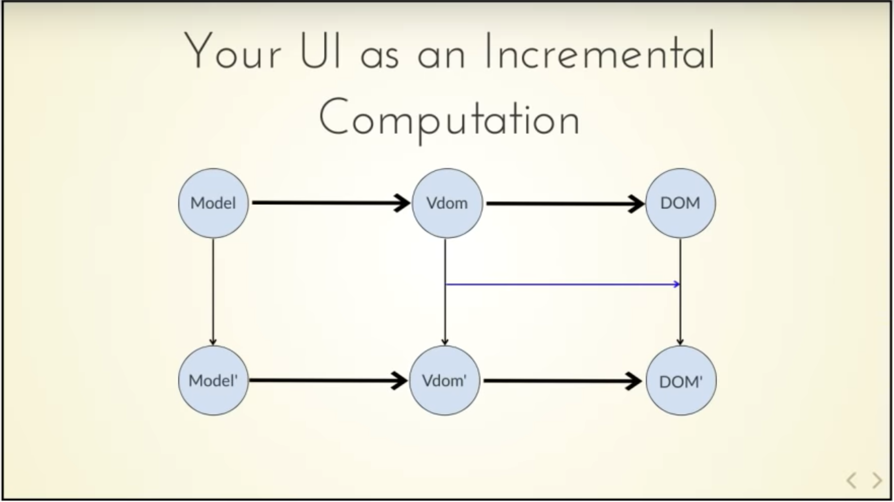
Δ

Slide 31
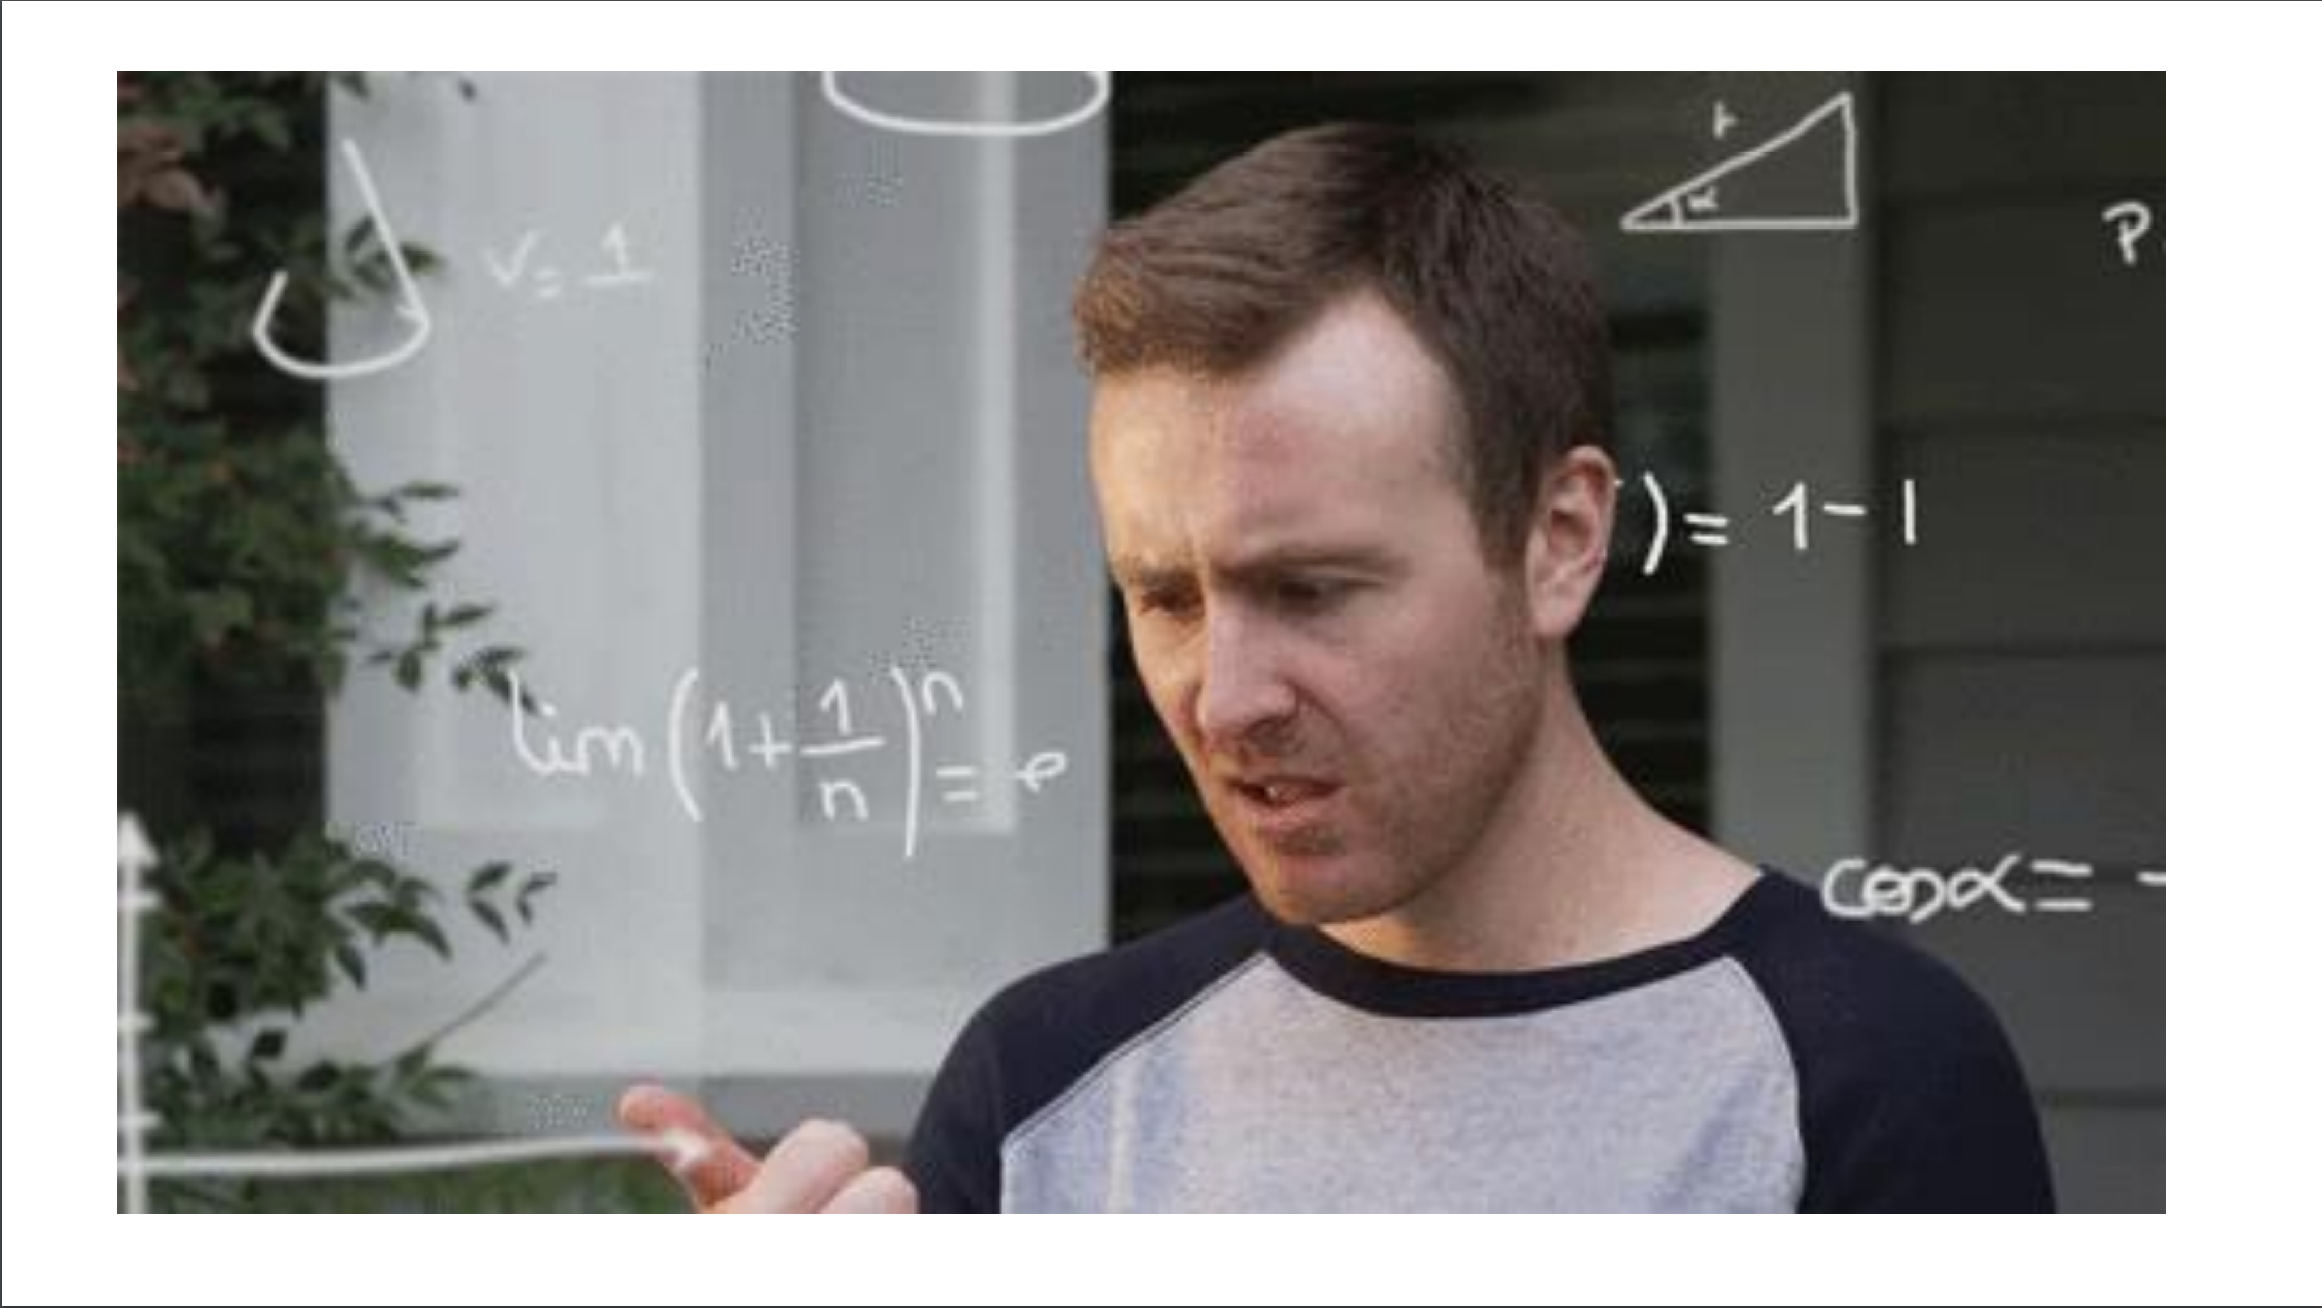

Slide 32
A Simple MVU App
type Model =
{ … }
type Msg =
| …
| …
let init() =
{ … }
let update msg model =
match msg with
| … -> { model with … }
| … -> { model with … }
let view model dispatch =
if model.IsPressed then
… dispatch msg …
else
… dispatch msg …
The model from which
the view is generated
Messages which cause
updates to the model
Initial state
Update the model
Compute the view

Slide 33
A Simple MVU App
type Model =
{ IsPressed: bool }
type Msg =
| Pressed
let init() =
{ IsPressed=false }
let update (msg: Msg) (model: Model) =
match msg with
| Pressed -> { model with IsPressed = true }
let view (model: Model) dispatch =
if model.IsPressed then
View.Label(text="I was pressed!")
else
View.Button(text="Press Me!", command=(fun () -> dispatch Pressed))
The model from which
the view is generated
Messages which cause
updates to the model
Initial state
Update the model
Compute the view

Slide 34
MVU
It’s all just functional programming
UI becomes an information-flow problem
Views and model update are just functional programming
Views are re-computed and differentially applied
Messages are explicit and easy to trace

Slide 35
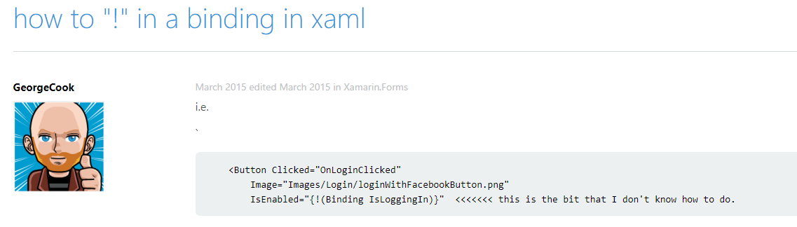
THE PROBLEM WITH XAML

Slide 36
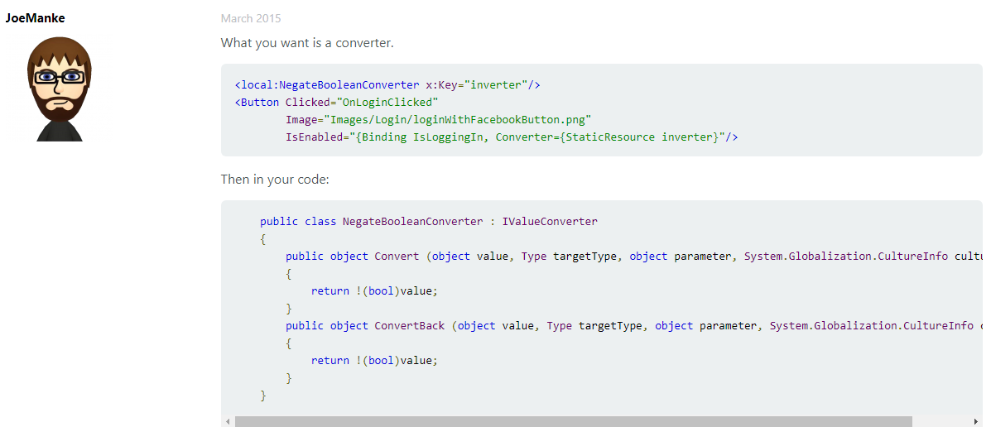
THE PROBLEM WITH XAML

Slide 37
The VIEW DSL
View looks like this:
let view (model: Model) dispatch =
View.ContentPage(content=
View.StackLayout(padding=30.0,verticalOptions = LayoutOptions.Center, children=[
View.Label(text= string model.Count, horizontalOptions=LayoutOptions.Center)
View.Button(text="Increment", command= (fun () -> dispatch Increment))
View.Button(text="Decrement", command= (fun () -> dispatch Decrement))
View.Slider(minimum=0.0, maximum=10.0, value=model.Step,
valueChanged= (fun args -> dispatch (SetStep (int args.NewValue))))
View.Label(text=sprintf "Step size: %d" model.Step, horizontalOptions=LayoutOptions.Center)
View.Button(text="Reset", horizontalOptions=LayoutOptions.Center,
command=(fun () -> dispatch Reset), canExecute = model.Changed)
]))

Slide 38
The VIEW DSL
View looks like this:
let view (model: Model) dispatch =
View.ContentPage(content=
View.StackLayout(padding=30.0,verticalOptions = LayoutOptions.Center, children=[
View.Label(text= string model.Count, horizontalOptions=LayoutOptions.Center)
View.Button(text="Increment", command= (fun () -> dispatch Increment))
View.Button(text="Decrement", command= (fun () -> dispatch Decrement))
View.Slider(minimum=0.0, maximum=10.0, value=model.Step,
valueChanged= (fun args -> dispatch (SetStep (int args.NewValue))))
View.Label(text=sprintf "Step size: %d" model.Step, horizontalOptions=LayoutOptions.Center)
View.Button(text="Reset", horizontalOptions=LayoutOptions.Center,
command=(fun () -> dispatch Reset), canExecute = not model.Unchanged)
]))
How easy is that?

Slide 39
THE NEED
What’s needed?
the simplicity of MVU, but for Mobile and Desktop Apps

Slide 40
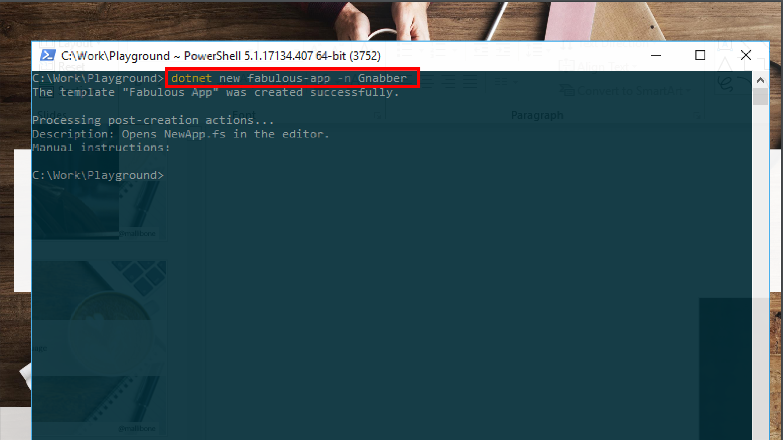

Slide 41
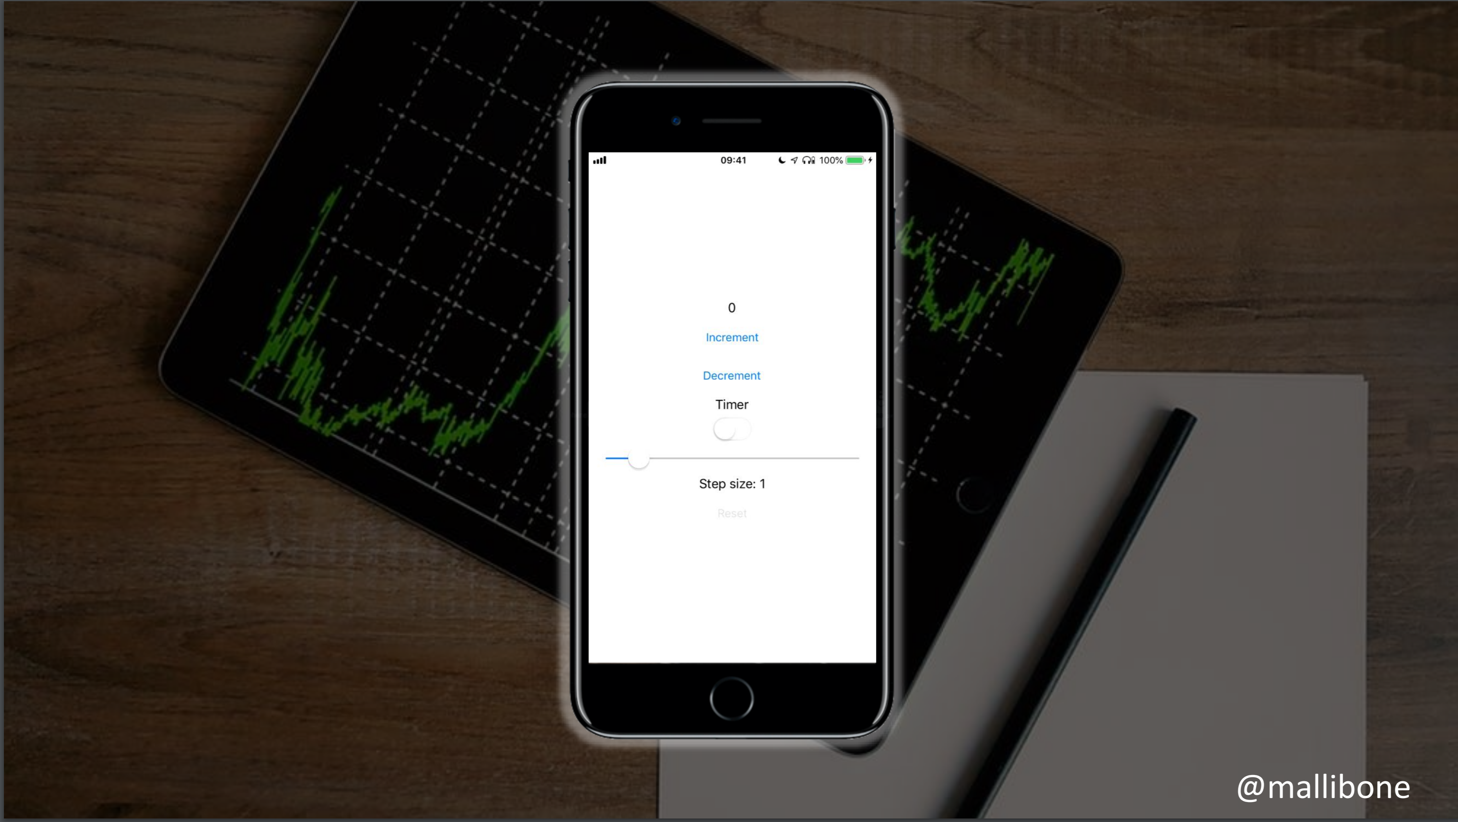

Slide 42
Demo I

Slide 43
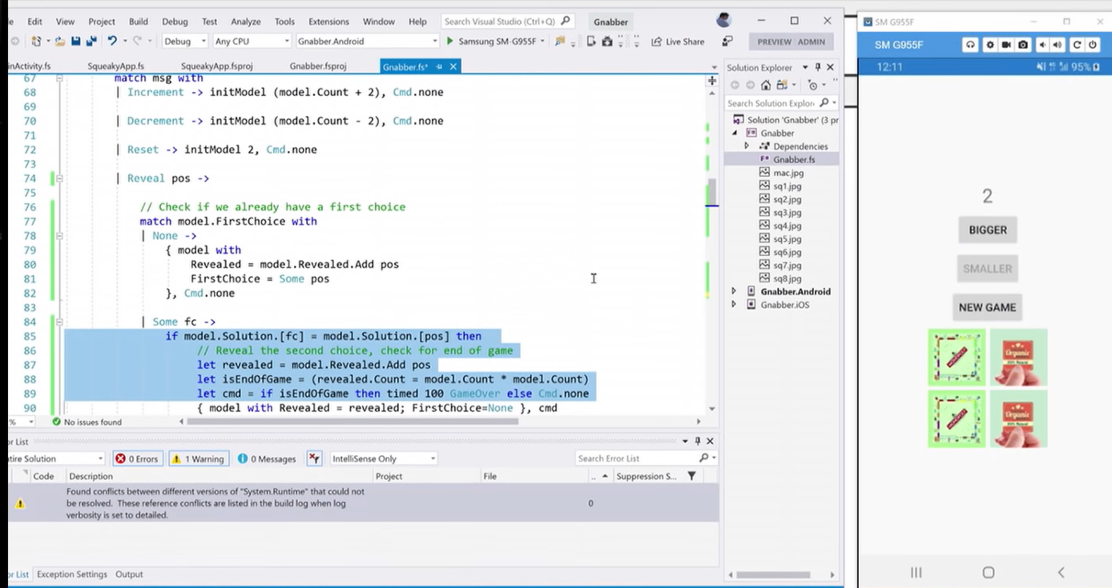

Slide 44
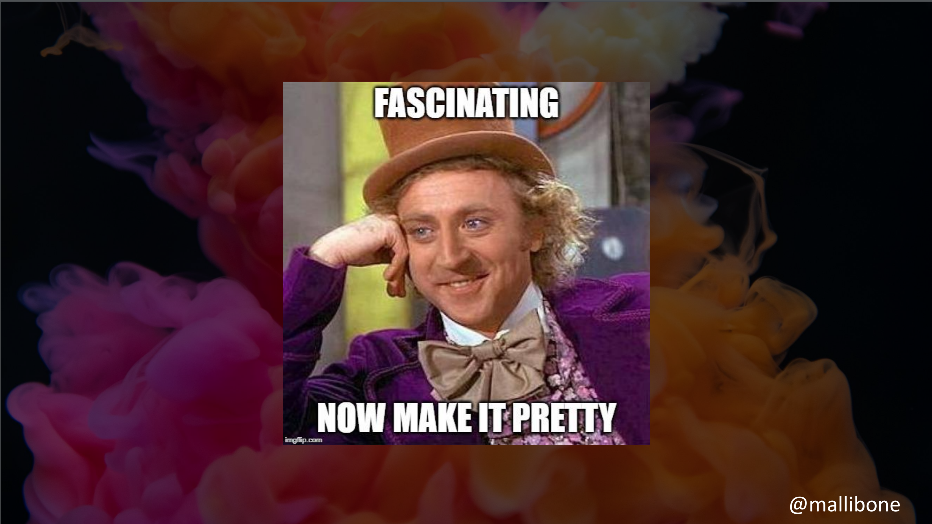

Slide 45
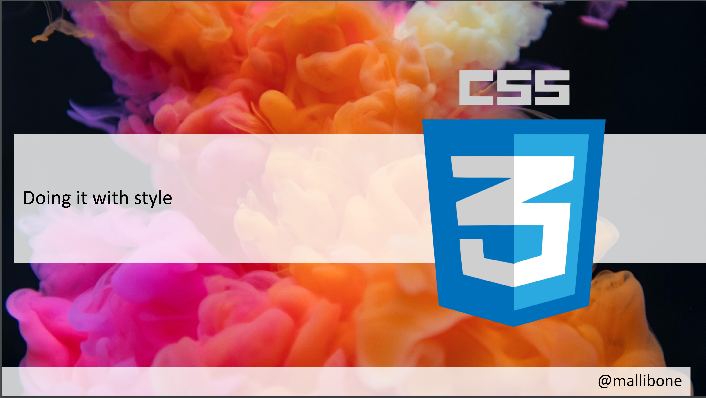

Slide 46
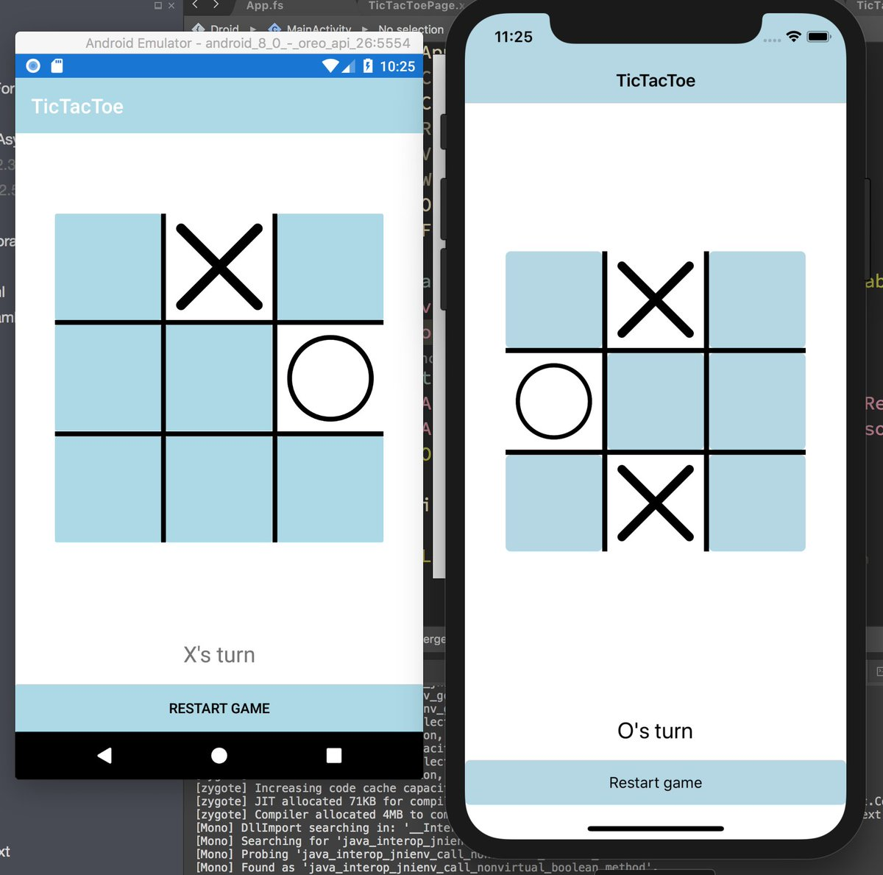
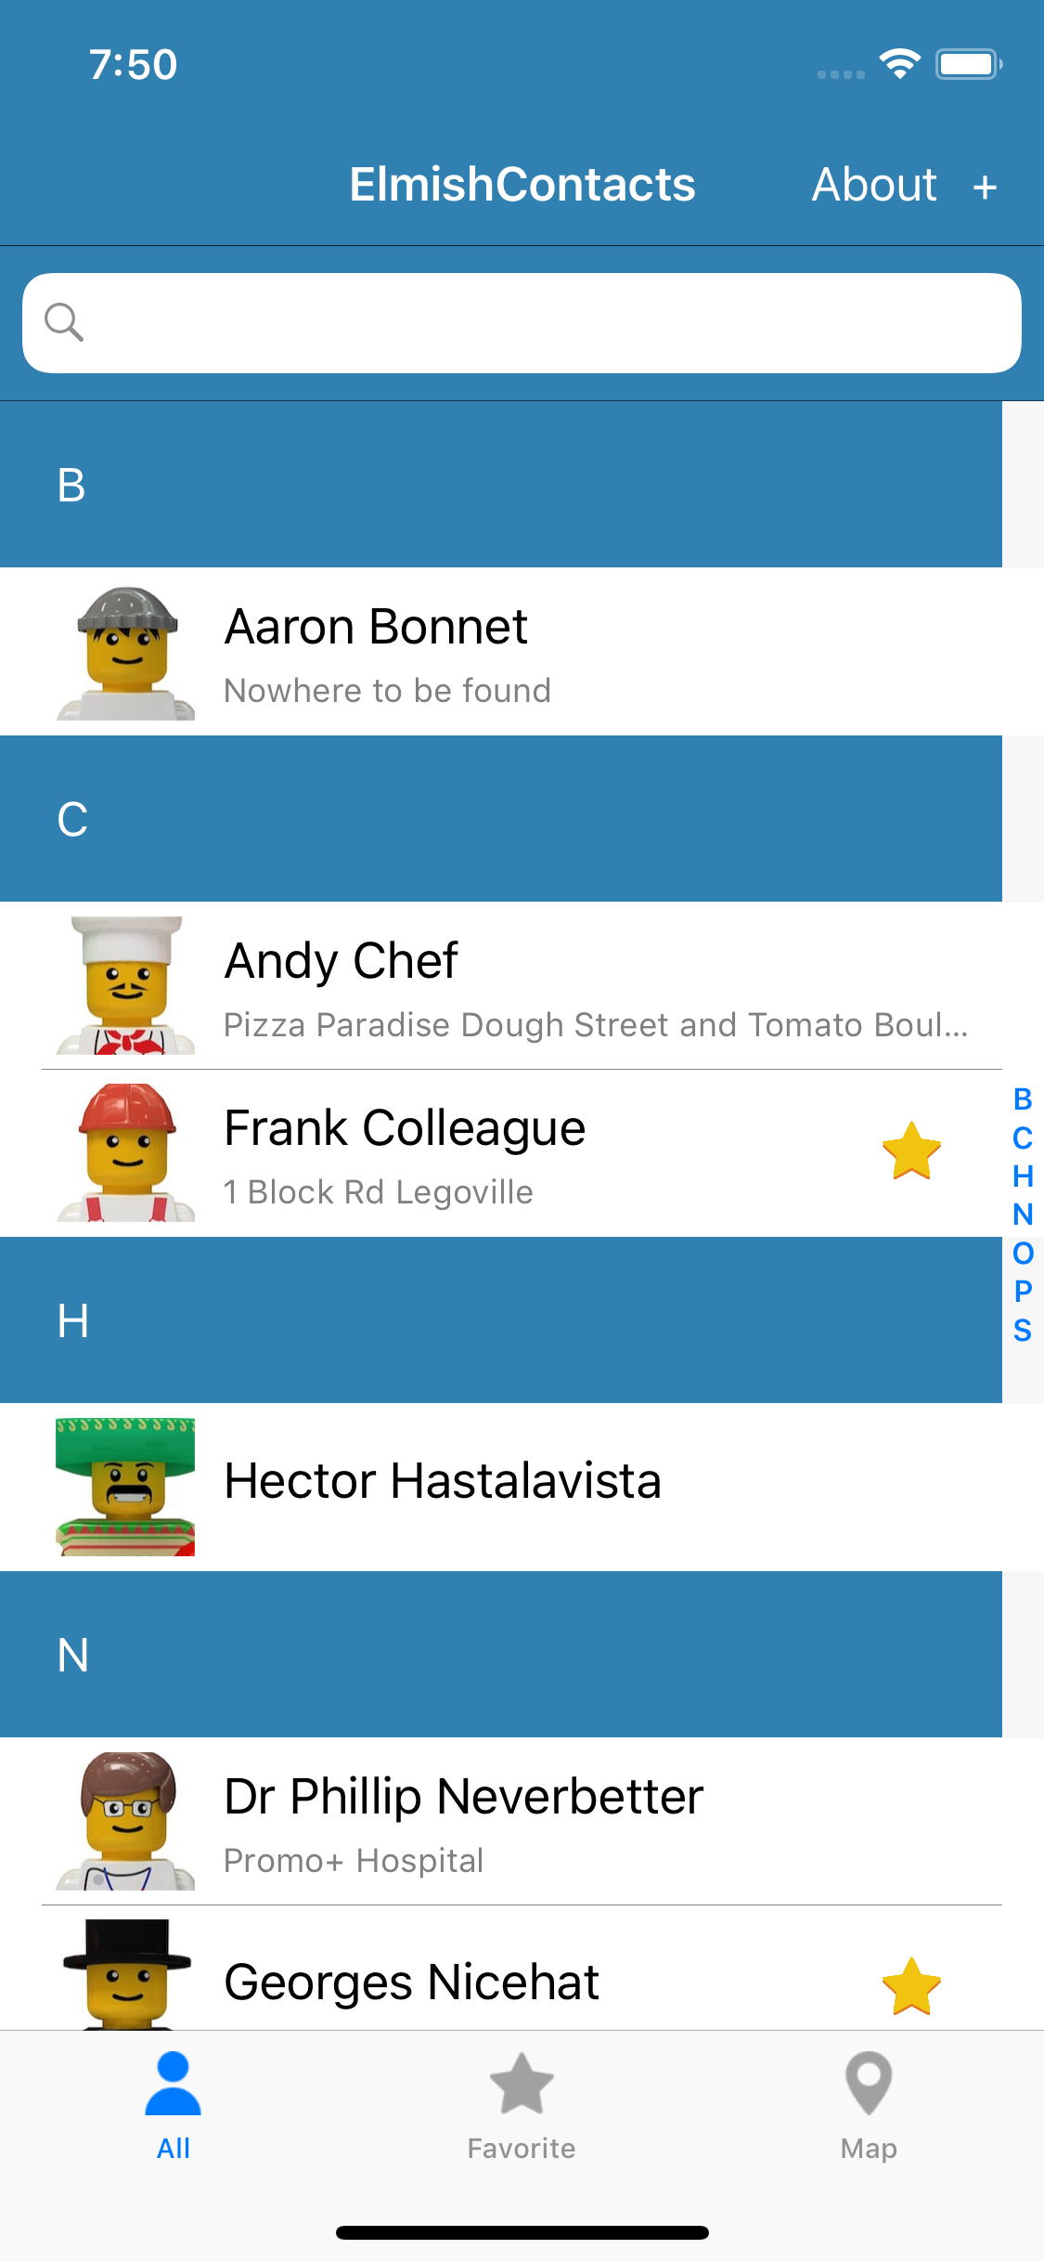
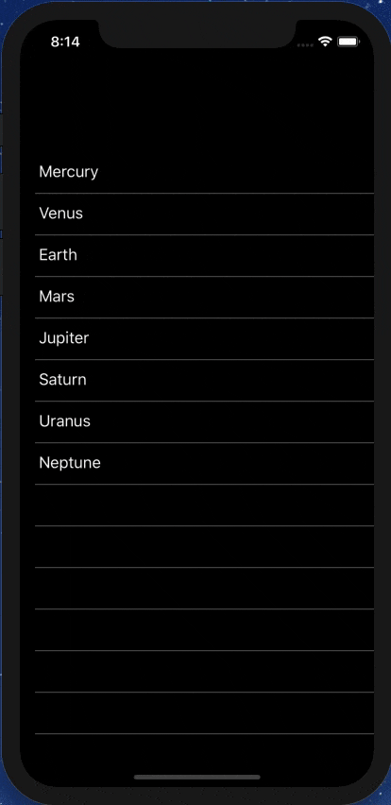
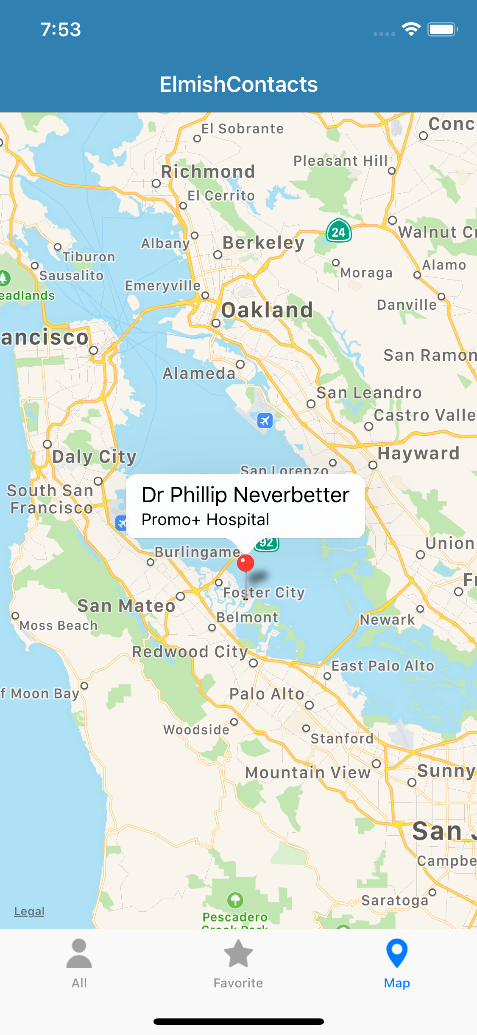
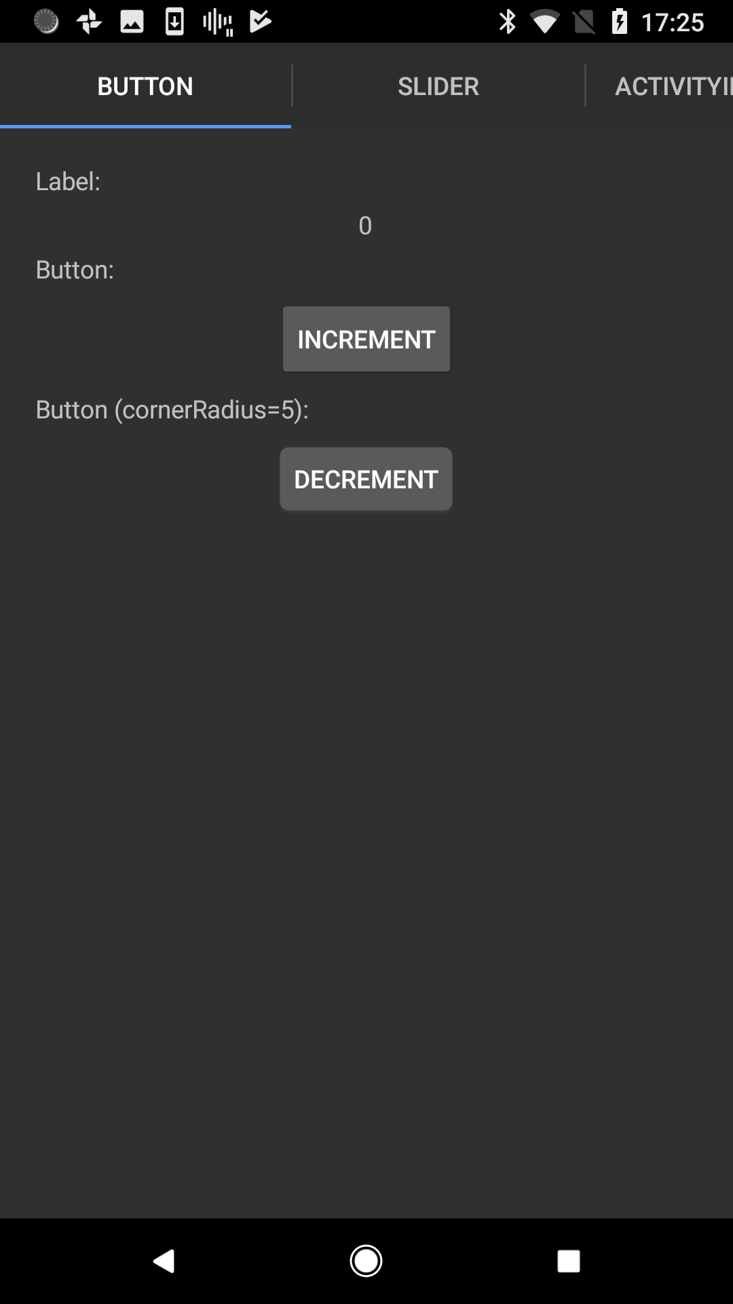

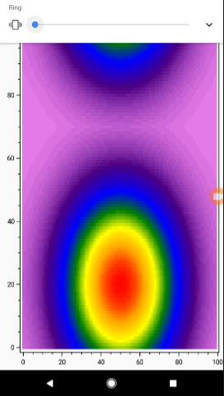


Slide 47
ELMISH CONTACTS

Slide 48
LEARN!
ElmishContacts is a great example
On-device per-app SQL-Lite integration
Using maps
Asynchronous data loading onto maps
Catching exceptions and being robust
Sending SMS, making phone calls and Email using Xamarin.Essentials
Multi-page with external messages reconciled via the composed app
Editing and searching lists of things
Taking photos
Splash screens
Decent design

Slide 49
The VIEW DSL
Xaml looks like this:

Slide 50
The VIEW DSL
View looks like this:
let view (model: Model) dispatch =
View.ContentPage(content=
View.StackLayout(padding=30.0,verticalOptions = LayoutOptions.Center, children=[
View.Label(text= string model.Count, horizontalOptions=LayoutOptions.Center)
View.Button(text="Increment", command= (fun () -> dispatch Increment))
View.Button(text="Decrement", command= (fun () -> dispatch Decrement))
View.Slider(minimum=0.0, maximum=10.0, value=model.Step,
valueChanged= (fun args -> dispatch (SetStep (int args.NewValue))))
View.Label(text=sprintf "Step size: %d" model.Step, horizontalOptions=LayoutOptions.Center)
View.Button(text="Reset", horizontalOptions=LayoutOptions.Center,
command=(fun () -> dispatch Reset), canExecute = model.Changed)
]))

Slide 51
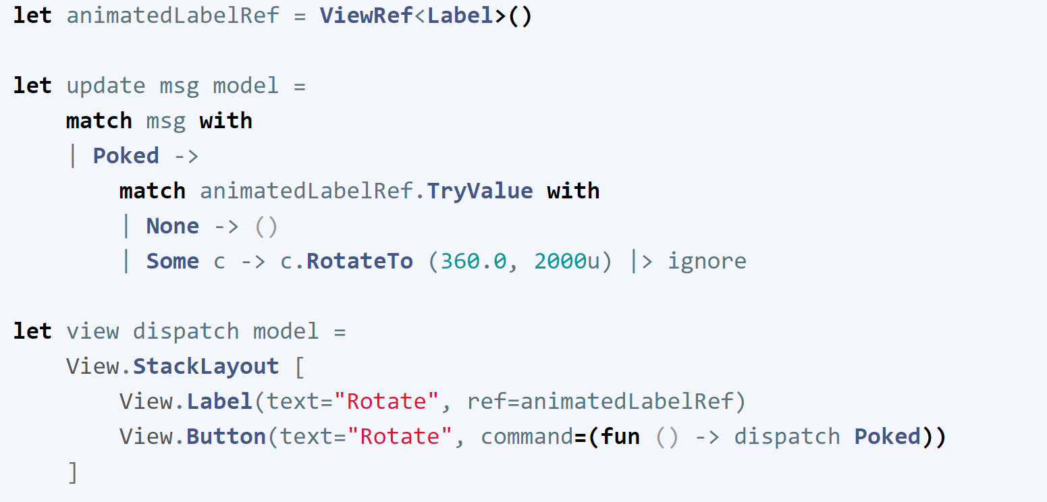
Animations
Yes you can
Uses “refs” like React

Slide 52
Multi-page apps
Yes you can
Still a single view function
CarouselPage, TabbedPage, NavigationPage with child pages
Each page has a model, message type and update function
You compose the pieces using F# code

Slide 53
Pragmatics
State persistence
Time-travel debugging
App size
Platform-specifics
Deploying
Extensibility

Slide 54
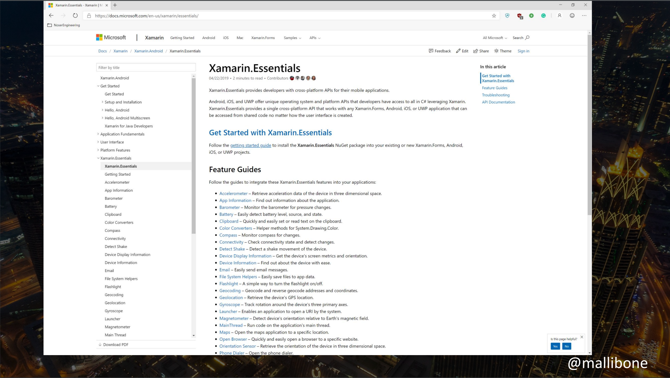

Slide 55
Making it efficient (HALF)
let view model dispatch =
…
View.Slider(minimum=0.0, maximum=10.0,
value=double model.Count,
valueChanged=(fun args -> dispatch (SliderValueChanged args.NewValue)))
…
This is a tree of immutable data describing the view
We want to avoid reallocating this data and re-traversing on each model update

Slide 56
Making it efficient (HALF)
let view model dispatch =
…
dependsOn (…) (fun model (count, step) ->
…
)
…

Slide 57
Making it efficient (HALF)
let view model dispatch =
…
dependsOn (model.Count, model.Step) (fun model (count, step) ->
View.Slider(minimum=0.0, maximum=10.0,
value=double count,
valueChanged=(fun args -> dispatch (SliderValueChanged args.NewValue))))
…
This recycles subtrees that are unchanged. Unchanged subtrees are not diff’d

Slide 58
MAKING IT EFFICIENT (OTHER HALF)
This is good, and enough for many information apps
We can do better, and it will be the focus of future work
Please come and help us apply Self-Adjusting Computations (incremental immutable data structures) to Fabulous
This is an invention of the PL community, and already applied in OCaml

Slide 59
Δ

Slide 60
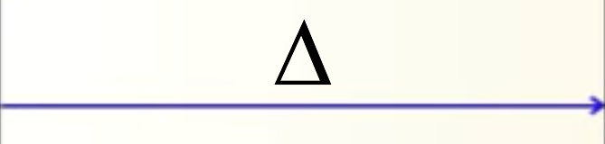
Δ
Δ

Slide 61
Possible window dressing
type Model =
{ … }
type Msg =
| …
| …
let init() =
{ … }
let update msg model = …
let view model dispatch = …
let app = mkApp (init, update, view)

Slide 62
Possible window dressing
[<ReflectedDefinition>]
type Model =
{ … }
type Msg =
| …
| …
let init() =
{ … }
let update msg model = …
let view model dispatch = …
let app = mkIncrementalApp (init, update, view)
Incrementalize the app,
(using F# quotations)

Slide 63
Summary

Slide 64
F# Emphasises Clear, Code to Solve Real-world Problems
MVU makes FP relevant to UI
R&D opportunities to apply incremental immutable data (SAC) for high perf
Fabulous brings this to cross-platform apps

Slide 65
Questions?

